Slide 1


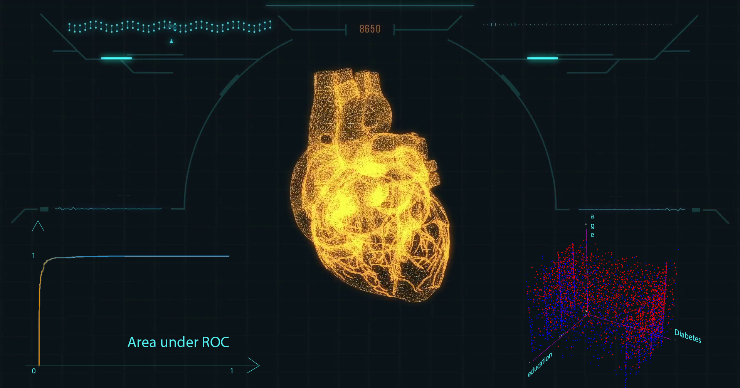
Coronary Heart Disease predicting using machine learning algorithms
Aladin Kapić and Prof.dr. Jasmin Kevrić
aladin.kapic@stu.ibu.edu.ba jasmin.kevric@ibu.edu.ba
Subject of this research is predicting Coronary Heart Disease (CHD). Dataset is based on Framingham Heart Study, founded in 1948. This dataset contains 4240 instances. There are 15 attributes and one single class - patient has or does not have CHD. Preprocessing of data performed due to incomplete information. Since dataset was imbalanced, the use of Synthetic Minority Over-sampling Technique (SMOTE) was necessary. Out of many algorithms, combination of Random forest and Kstar best performed.
HIGHLIGHTS
Prediction of Coronary Heart Disease.
Training set mostly based on artificial samples tested on real data.
Two classification algorithms combined with SMOTE.
Accuracy of prediction of CHD over 90%.
GRAPHICAL ABSTRACT
Random Forest
Summary | TP rate | ROC Area | Total Accuracy
Class True | 0.851 | 0.964 | 92.13%
Class False | 0.938 | 0.964
Lazy KStar
Summary | TP rate | ROC Area | Total Accuracy
Class True | 0.979 | 0.993 | 92.97%
Class False | 0.921 | 0.993
Name of Attribute | Possible Values | Name of Attribute | Possible Values
Gender | 2 | Has Diabetes | 2
Age Of Patient | 39 | Cholesterol Level | 242
Education Level | 5 | Systolic BP | 232
Smoking Habit | 2 | Diastolic BP | 142
Cigarretes per Day | 33 | Body Mass Index | 1312
BP Bedicaments | 3 | Heart Rate | 72
Had Stroke | 2 | Glucose Level | 142
Was Hipertensive | 2
Random Forest and Lazy KStar
Summary | TP rate | ROC Area | Total Accuracy
Class True | 0.971 | 0.989 | 94.00%
Class False | 0.934 | 0.989
RESULTS & ANALYSIS
The main keywords of this work are:
SMOTE & Resampling Data
Random Forest and KStar
SMOTE in this particular analysis played huge role. Creating synthetic artificial samples for training set, mixed with original real data gave unexpectedly useful results. Imbalanced dataset requiered creating almost 450% of synthetic samples of users with Coronary Heart Disease. Practice showed, oversampling both of clasess and then resampling up to 50% gave the best results.
In past, many habits and body conditions were considered as risk factors for Coronary Heart Disease. Here, in this dataset, we have two of them, at first sight irrelevant, education and cigarettes per day. Excluding them, number of correctly classified instances decreased.
The individual use of algorithms has yielded good results in the classification of one class, whether of sick or healthy patients. Random Forest showed as good candidate for clasification of healthy people. At the other hand, lazy KStar gave better results of
classification unhealty patients. Combining them together, individual TP rate of healthy and unhealthy patients slightly decreased, but almost indentical and over 90%.
At the end, after creating synthetic artificial samples and resampling, algorithms were teached enough to make good decision whether patient would have CHD or not. In future yaers, this could help doctors at least to confirm their opinions and maybe to change their minds.

